Slide 1
Hybrid Wind and Solar Generation System
Team: Daoxi Sun, Riley O'Connor, Trevor Webb, Shihao Ni, Xiaokai Sun, Ben Ryan
Advisor, Client: Venkataramana Ajjarapu
Mentor: Ankit Singhal
May 15-21

Slide 2
Problem Statement
Use stand-alone solar and wind generation to supply a load of up to 400 W

Slide 3
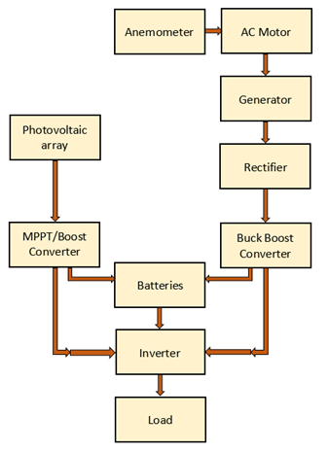
Conceptual Design
PV panel to generate solar power
Motor simulates wind power
Each system will individually manipulate DC
Combination of inputs then converted to AC
Battery bank to store excess power and
provide support as needed

Slide 4
Functional Requirements
Solar and wind generation together must provide for a
400 W load
A battery is connected to the system to help maintain the power
Should operate reasonably under a variety of conditions

Slide 5
Team Contributions
Wind and Solar Team duties
Riley O'Connor: solar team, team leader
Daoxi Sun: solar team, webmaster
Shihao Ni: wind team, webmaster
Xiaokai Sun: wind team, communication leader
Trevor Webb: solar team, communication leader
Ben Ryan: wind team, key concept holder

Slide 6
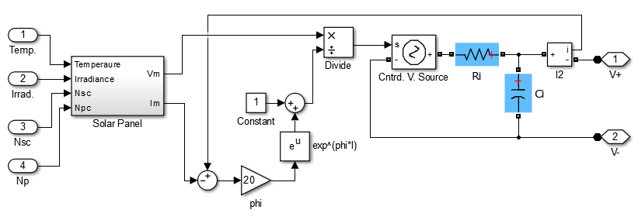
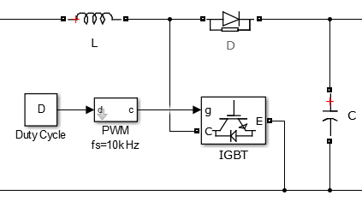
Functional Composition - Solar
Photovoltaic panels generate solar power,
dependent on a variety of conditions
Boost Converter with MPPT maximizes
power output
Simulation of solar panel equations
Boost Converter schematic

Slide 7
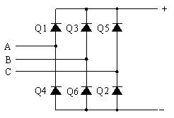
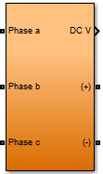
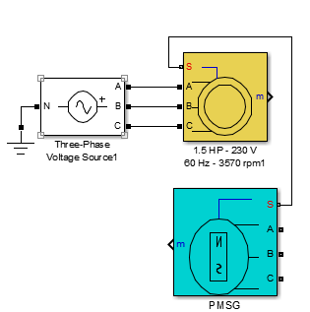
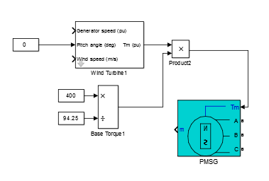
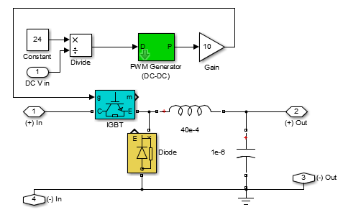
Functional Composition - Wind
Anemometer
Induction Motor, PMSG
Rectifier
Buck-Boost Converter

Slide 8
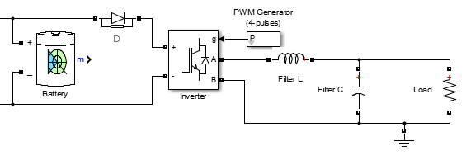
Functional Composition - Load Side
Battery Bank for powering load, compensating for poor conditions
Inverter converts DC to AC voltage
Filter output waveform
to load
PI Controllers handle switching
behavior

Slide 9
Detailed Design - Solar
Functional solar design

Slide 10
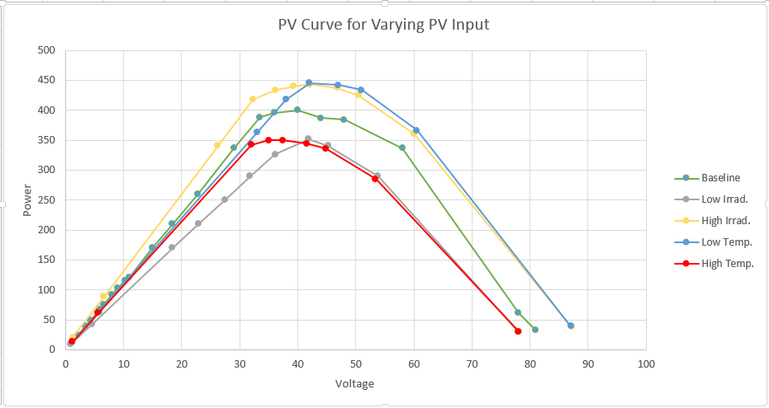
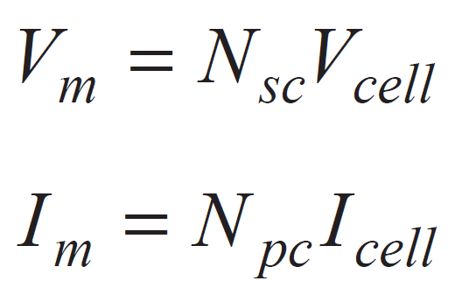
Solar Panel Simulation
0.5 v per cell maximum
~36 cells in a panel
0.5 * 36= 18 V maximum

Slide 11
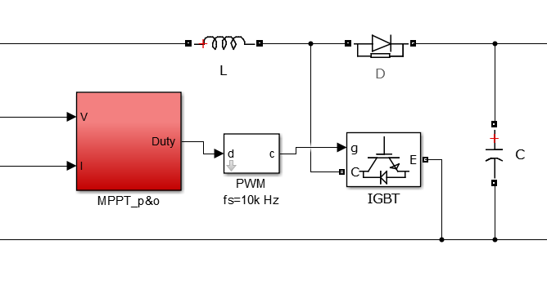
MPPT and Boost Converter
MPPT: perturbation and observation
Boost converter:
step up voltage
based on duty cycle

Slide 12
Load with Inverter and Filter

Slide 13
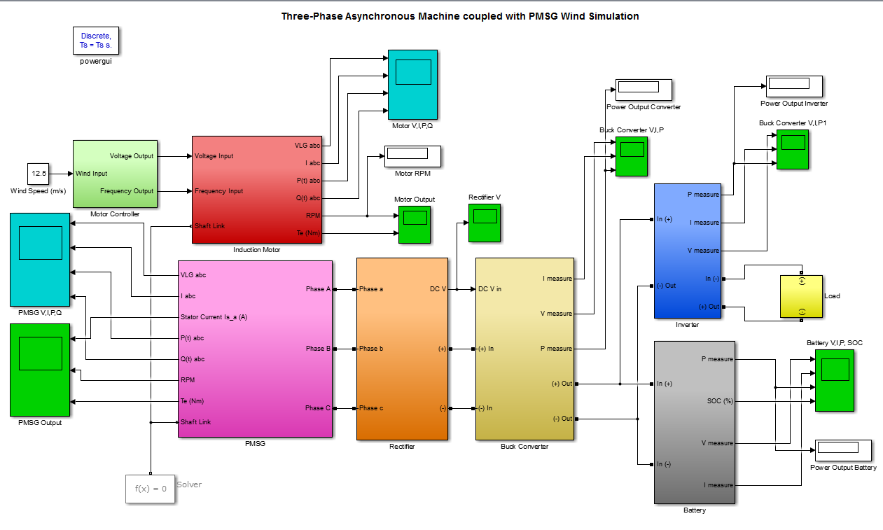
Detailed Design - Wind
Functional
Wind
Design

Slide 14
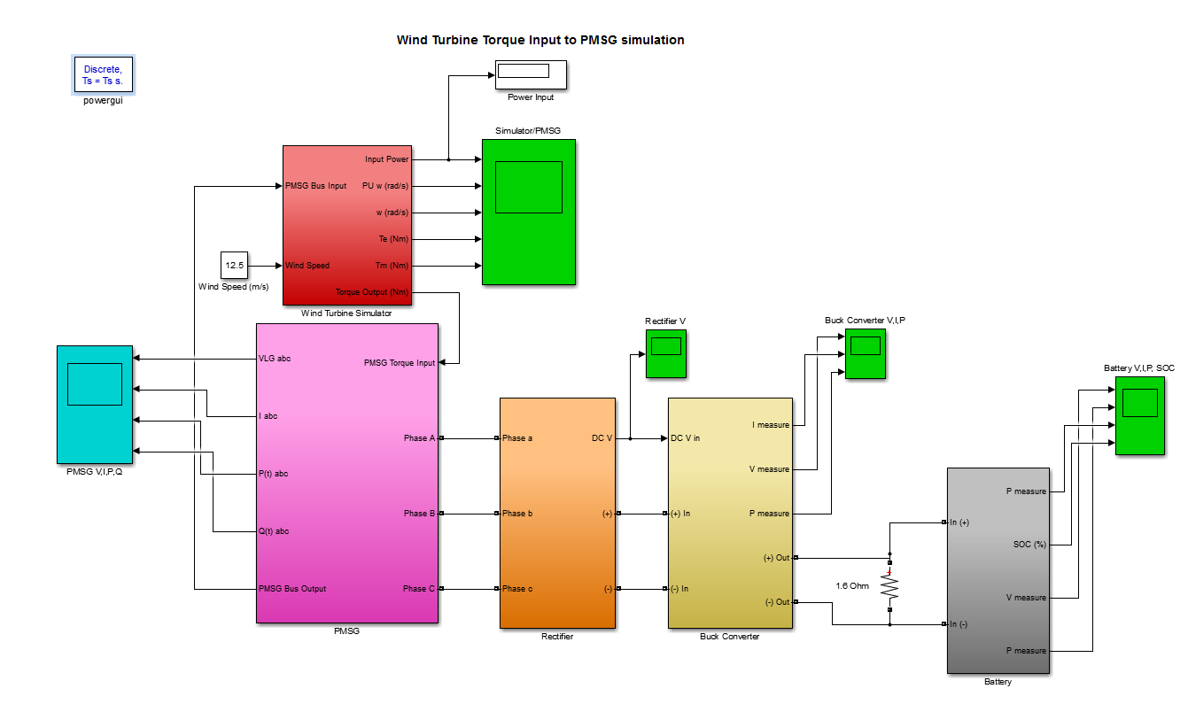
Detailed Design - Turbine Simulation
Turbine
Torque
Input

Slide 15
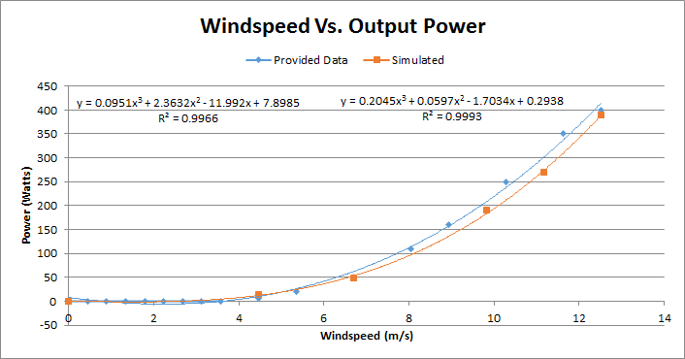
Detailed Design - Results

Slide 16
Detailed Design - Combined
DC voltage bus tie
Power flow at the fixed DC voltage bus sums to zero
Battery consumes or absorbs power

Slide 17
Testing and Implementation
Separate system simulations
Individual components: input and output procedure
Functioning hybrid system for demonstrations

Slide 18
Challenges
Power output cannot exceed the rating of the device
Becoming familiar with individual hardware components and troubleshooting them
Differences between theoretical simulation and practical applications

Slide 19
Parts Estimate
Boost Converter, MPPT, Motor Controller, various passive circuit elements
May need more when hardware process begins

Slide 20
Fall Timeline

Slide 21
Spring Timeline

Slide 22
Current Status
Individual simulations completed
Need to combine simulations
Ready to move on to hardware testing

Slide 23
Plans for Next Semester
Basic simulation for both solar and wind complete
Using designs from the simulations to test hardware behavior
Solar and wind teams will need to test separately at first
Comprehensive model will then be simulated
Finally solar and wind components will be connected together and complete model will tested

